Slide 1
Yvonne Ali
^{APH Information Resources}
MSB Outreach Services
You are familiar with and use APH products daily.
In support of their mission to promote the education of the blind and visually impaired, APH has resources that provide background information about their products and related issues.
This presentation will focus on 1) these readily available resources that can provide support to you as a teacher of the visually impaired and 2) what’s new at APH.
“Half of Knowledge is Knowing Where to Find It”
Anonymous
August 2014

Slide 2
APH Registration
Quick Overview
APH Annual Report has Aggregate Data from Nationwide Registration Online http://www.aph.org/about/#annual-reports
Federal Quota Reference (http://www.aph.org/advisory/#federal-quota-reference)
Notes:
Open Federal Quota Reference

Slide 3
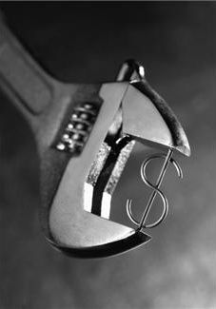
Budget Cuts Due to Sequestration
5% cut in 2013
7% additional cut in 2014
Leader to Leader Program

Slide 4
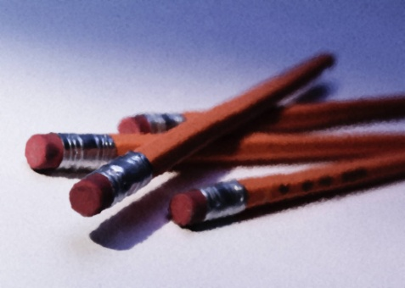
2014 APH Registration
Eye Measurements – Definitions Clarified
Primary Language Used for Instruction
Grade Placement Codes Changed
Documentation for FDB amended to include any medical doctor
No changes expected in 2015
Notes:
Significant Changes:
20/101 – 20/199
OP and LP clarified
Primary Language changed from “primary spoken language” to “primary language used for instruction in the classroom”
Grade Placement codes for Vocational and Post-Graduate have been deleted
Codes “Functional Curriculum” (FC) and “Transition” placement added.
FDB amended to include a report from eye care specialist or any medical doctor.

Slide 5
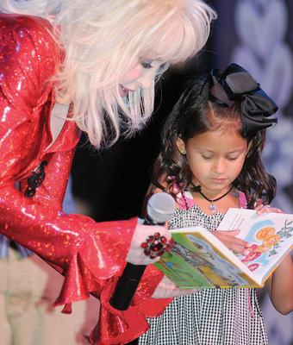
APH Dolly Parton Partnership
APH & Dollywood Foundation began partnership to expand the DPIL to children age 5 and under and likely to use braille as their reading medium with accessible books in audio and print/braille formats
The parent or legal guardian must complete an application for the program
See the FAQs section
http://www.aph.org/dolly-partons-imagination-library/
Notes:
Website has links to other sources of print/braille and tactile books for preschoolers
Info about emergent literacy & sharing books with young children w/VI

Slide 6
Physical Education
In January 2013, the Office of Civil Rights, US Dept of Education, issued guidance detailing LEA’s legal obligation to provide students with disabilities equal access to athletic activities.
Text of the “Dear Colleague Letter”
http://www.activepolicysolutions.com/wp-content/uploads/2013/01/IFC_ReleaseforOCRDC-final.pdf
Schools are to look broadly and proactively to include students with disabilities in athletic programs in order to satisfy the school’s civil rights obligations to provide equal educational opportunities.

Slide 7
APH Physical Education Website
APH PE Home
(http://www.aph.org/pe/)
A comprehensive parent/teacher resource for children with sensory impairments that focuses on PE & recreation
Sections include:
• PE Programs
• Organizations
• Advocacy
• Equipment
• Mailing lists
National Services
Products
• Sports Camps
• Toys & Game
Videos
Websites
and more
Click Here To Add Text.
Notes:
PE Programs (6)
Organizations (26
Advocacy (2)
Articles: 71 articles; 5 theses/dissertations; 17 journals
Book Resources: 38 books
Equipment Ressources: 17
Events, Workshops, Trainings
Features – The Development of Blind Tennis; previous features listed
Magazines: 7
Mailing Lists and E-Lists: 13
National Service Links: 8
PE Products: all APH
Regional & State Agencies, etc.: For MO – RSB & MSB
Sports Camps 2013: None listed for MO
Technology: includes virtual sports, virtual tennis, and Switches
Toys & Game Resources:12
Videos: over 70
Websites: 22

Slide 8
APH PE Products
Lauren Lieberman Books
Walk Run Fitness
30 Love
Sound Balls
Rib-it-Balls
Jump Rope
and more
Notes:
Lauren Lieberman Books: “Everybody Plays” & “Games for People with Sensory Impairment: Strategies for Including Individuals of All Ages”

Slide 9
Common Core State Standards
Common Core Standards Website www.aph.org/ccss
Links to the
Common Core Standards with Math & English standards & the Maryland CC Curriculum for Braille
The five Assessment Consortia: PARCC, Smarter Balance, Dynamic Learning Maps, NCSC, and ASSETS
APH Products for Teaching the CCSS
Notes:
Open link

Slide 10
APH Products for Teaching CCSS
http://www.aph.org/ccss/products.html
Site lists APH math product aligned to CCSS for grades K-8
Follow the links by Grade Level
Includes MathBuilders and other products
Grades 9-12 coming soon
Notes:
Open APH Products CCSS link

Slide 11
Common Core State Standards
Building on Patterns CCSS
http://www.aph.org/edresearch/BOP-Kindergarten-Common-Core-State-Standards.htm
Site lists the CCSS for English and Language Arts and information on where they are addressed in BOP Kindergarten
Lesson numbers are listed next to the standard where a particular lesson addresses that standard
Notes:
Open link

Slide 12
Building on Patterns Homework
Homework assignments mentioned in the Teacher’ edition available online can be printed and given to the student:
BOP First Grade: http://www.aph.org/edresearch/bophomework.pdf
BOP Second Grade: http://www.aph.org/edresearch/bop2homework.pdf

Slide 13
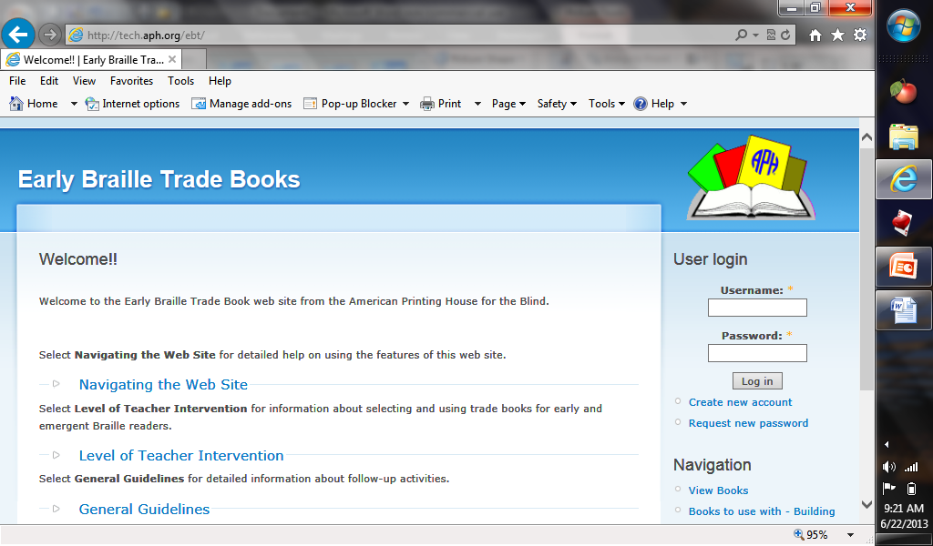
EBT Database
http://tech.aph.org/ebt/
Record information on braille students & the EBT books read
Contractions: 189 contractions, punctuation and composition signs learned by the student
Select books that contain specific contractions, support a BOP Unit, or ECC topic
Notes:
Open Link, then Navigating the Web Site

Slide 14
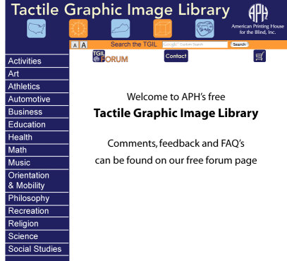
Tactile Graphics
BANA Tactile Graphics Guidelines online (BANA website) and in print from APH
Tactile Graphics Image Library
www.aph.org/tgil
Webinar
“Braille Transcriber & Teacher Training - Tactile Graphic Image Library + Graphic Freeware = Meaningful Cost-Efficient Graphics” by Anthony Slowinski www.aph.org/training/aslowinski/
Notes:
Open TGIL
Use of Inkscape software with TGIL;
BANA http://www.brailleauthority.org/tg/web-manual/index.html
APH Catalog # for print Guidelines 7-35935-00; print supplement 7-25936-00
Also available in braille.

Slide 15
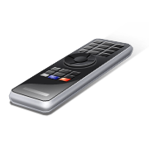
APH Tactile Graphics TV
www.aph.org/tgtv
A series of online videos devoted to tactile graphic design (3 episodes currently available)
Each episode will address one or two aspects of the design process involved in adapting a print graphic into a readable tactile image
Emphasis is on the way to think about tactile adaptation rather than the “do’s and don’ts”
Notes:
Can download into mp3 or mobile phone

Slide 16
The Quick Tips Video Series will include very short videos, each of which focuses on a particular tip to help make your work a little easier!
New tip added each week (17 as of 10/28)
http://www.aph.org/quick-tips/
Notes:
Open Link

Slide 17
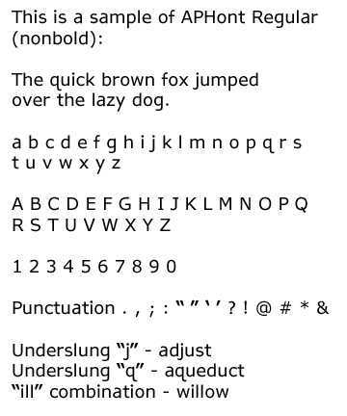
APHont™: A Font for Low Vision
Free Font Download for Qualified Users
APHont™ (pronounced Ay'-font)
APHont embodies characteristics that enhance reading speed, comprehension, and comfort for large print users
More even spacing between letters
No serifs
Wider letters
No crossbars, etc.
The APHont Suite consists of Regular, Bold, Italic, and Italic Bold.
You must certify use for or by a person with a visual impairment before downloading
http://www.aph.org/products/aphont/
Notes:
Features
More even spacing between letters.
Higher crossbars.
No serifs.
Wider letters.
Heavier letters.
Underslung "j" and "q".
Letters more open.
Larger punctuation marks.

Slide 18
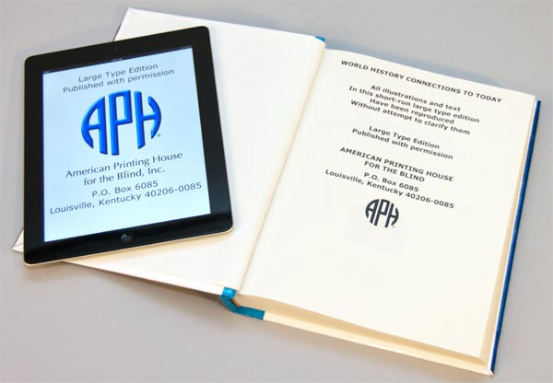
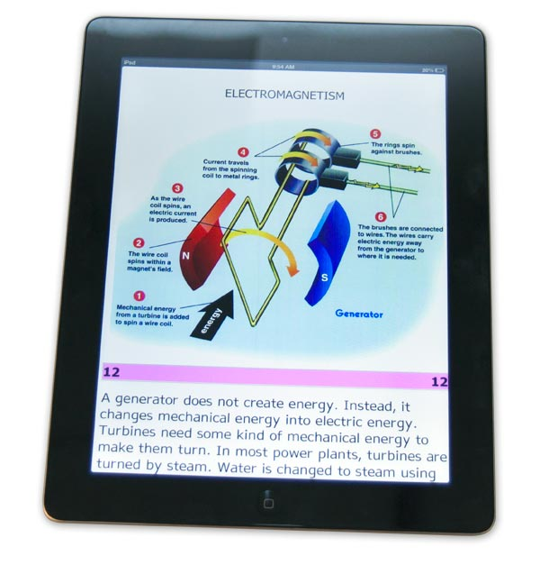
Large Print Texts for eReaders
Complete content of the original print edition, formatted for improved accessibility using APH’s proprietary in-house process.
Minimum 18-pt. font, enlarged images
A color palette designed for accessibility and clarity
Only available if the LP has been created using the ATIC Special Enlargement process
High quality with graphics correctly embedded
For use on an eReader only – e-book cannot be printed
Drop Box Account necessary for transmission

Slide 19
Transcribers may be interested in the “APH Braille Transcription Specifications”
Designed to transcribe braille textbooks with the highest quality and most useful methods for blind students.
APH encourages all transcribers to use these specifications for transcribing braille textbooks. APH staff is available to answer questions about the specifications, whenever you have them. Please see the listing of contacts at the end of this document.
http://www.aph.org/atic/atic_transspecs.html

Slide 20
Position Papers Statements on Important Issues
Abacus Position Paper
Use of Extended Time
Accommodations for Testing Students with Visual Impairments
Intelligence Testing of Individuals Who Are Blind and Visually Impaired
http://www.aph.org/tests/index.html

Slide 21
Links to Assessment Resources
Test Publisher Contact Information
In the Research Section - Access to the National Center on Educational Outcomes Accommodations Bibliography
http://www.aph.org/tests/index.html

Slide 22
APH Migel Library APH Continues the AFB Legacy
http://migel.aph.org/catalog/CategoryInfo.aspx?cid=152
This is one of the largest known collections of materials related to blindness and visual impairment in the U.S.
The collection houses approximately 20,000 print, audio, video and other items.
The material ranges in scope from research reports and theses to published fiction and non-fiction materials.
Select items are full-text and available for free download; see the FAQs: http://archive.org/about/faqs.php#Texts_and_Books

Slide 23
SAM Websites
SAM Assessments and Games online
(http://tech.aph.org/sam/ ) for SAM Assessments
(http://tech.aph.org/samvid/) for SAM videos. Try Google Chrome if Internet Explorer doesn’t’ work)
Thumb drive in back of volume 1 of Guidebook contains Sound Folder (35 common environmental sounds). Copy this folder to your computer.
The thumb drive cannot be separately re-ordered. Back it up!
Digital Video Recorder cannot be re-ordered. Operating instructions are on the thumb drive.
Notes:
Just brief discussion since Millie will be presenting at AER

Slide 24
APH Products
How to Find Them & What’s New

Slide 25
Finding APH Textbooks
Louis Database (http://louis.aph.org/)
Texts produced by APH and commercial vendors
Searching by ISBN most reliable way to locate a title
Can search both Louis Database & NIMAC Repository in one search box
Notes:
Ask: Have you used Louis Database?

Slide 26
Finding APH Products
APH Shopping Site (http://shop.aph.org/)
New & Revised APH Products
Discontinued Products
Recommended Products
Downloadable Product Manuals http://www.aph.org/manuals/
MIRC Tactile Graphics Products List (http://msb.dese.mo.gov/documents/TactileGraphicsProducts2012.pdf)
Notes:
Open Shopping

Slide 27
Product Training
http://www.aph.org/products/#audio-video
Videos including user-made videos “Unforgettable Stars”
Webcasts
PowerPoint Presentations
YouTube Videos
Ask for my list
NIP Events
Software & AT Devices: http://tech.aph.org/
User’s Guides, upgrade history, other resources

Slide 28
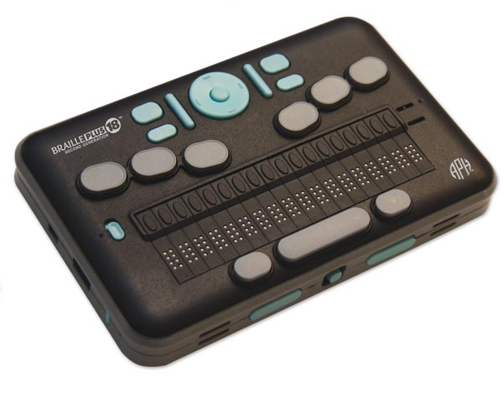
Technology Products
http://tech.aph.org/
Be Sure to check the User Manuals
Updates
BP18 & TI-84 resources, i.e., podcasts, videos, classroom guides
Notes:
Open BP18, Resources, Classroom Activities

Slide 29
Annual Research Report
Reports from several years available online: http://www.aph.org/edresearch/#research-resources
How I Use These Reports

Slide 30
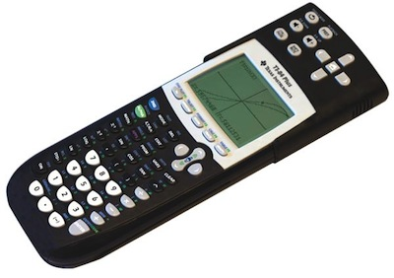
New Products Focused on STEM
Accessible TI-84 Plus Graphing Calculator
Tactile Tangrams
Tactile Punnett Squares
Re-designed Number Line Device
Ezee Count Abacus
Expanded Beginner’s Abacus
Multiplication & Division Tables
DNA Twist
Be sure to see the APH Product Display for these and more new products!

Slide 31
You Can Be a Part of the Development Process
Field Trial Opportunities
Product Surveys (multiple disability, etc)
Your New Product Ideas

Slide 32
“Alone we can do so little; together we can do so much.” Helen Keller
MIRC e-Mail List
AT Expertise List? Who are our AT Superstars?

